Slide 1
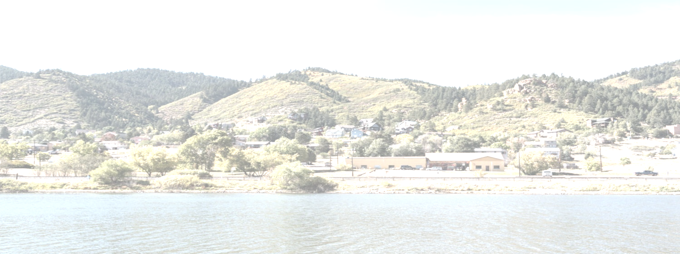

Slide 2
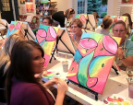
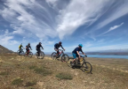
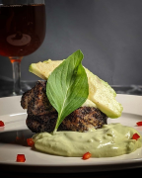
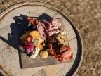
Outdoors
ArtS
History
Dining

Slide 3
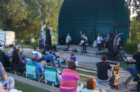
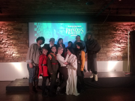
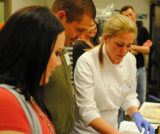
Art
Live Music
Performing Arts
Film Screenings / Movie Nights
Community Art Classes
Cooking Classes
Artist in Residence Program
Co-op Art Gallery

Slide 4
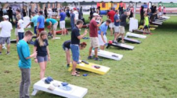
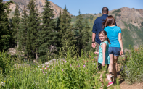
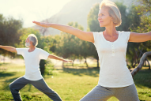
Outdoors
Community Sports Leagues
Weekly Bike Gatherings
Walking, Running and Trail Hiking
Movement Studies

Slide 5
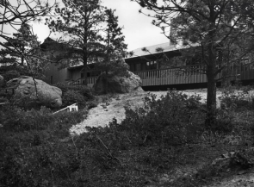
History
Organic Farm and Meadows
Animal Education
Intentional Preservation
Sustainability
Community Garden
Hop Yard, Orchard
Cultivating Community

Slide 6
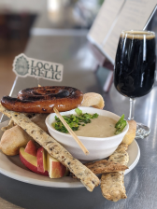
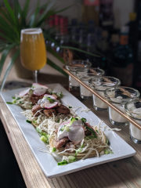
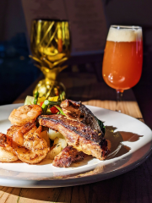
Dining
Common Cup
Bread, Board and Bottle
Locals
Paired Fare

Slide 7
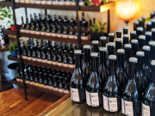
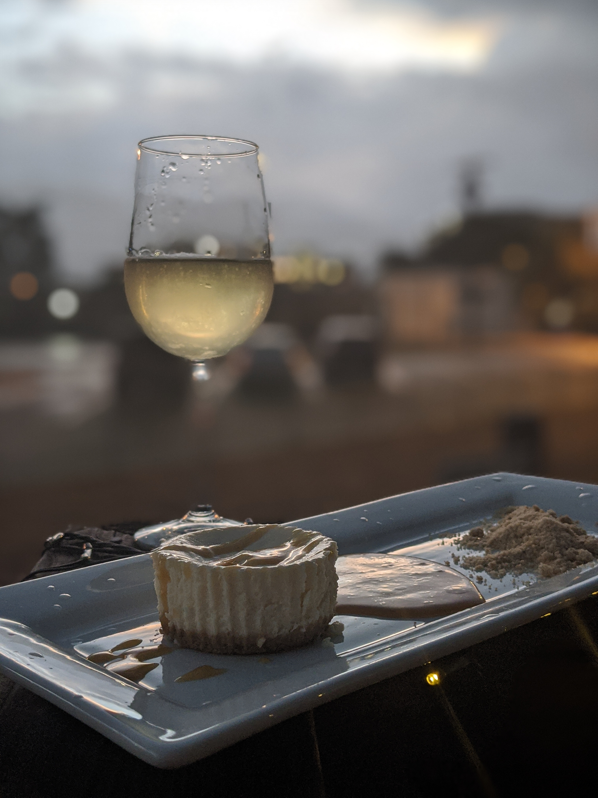
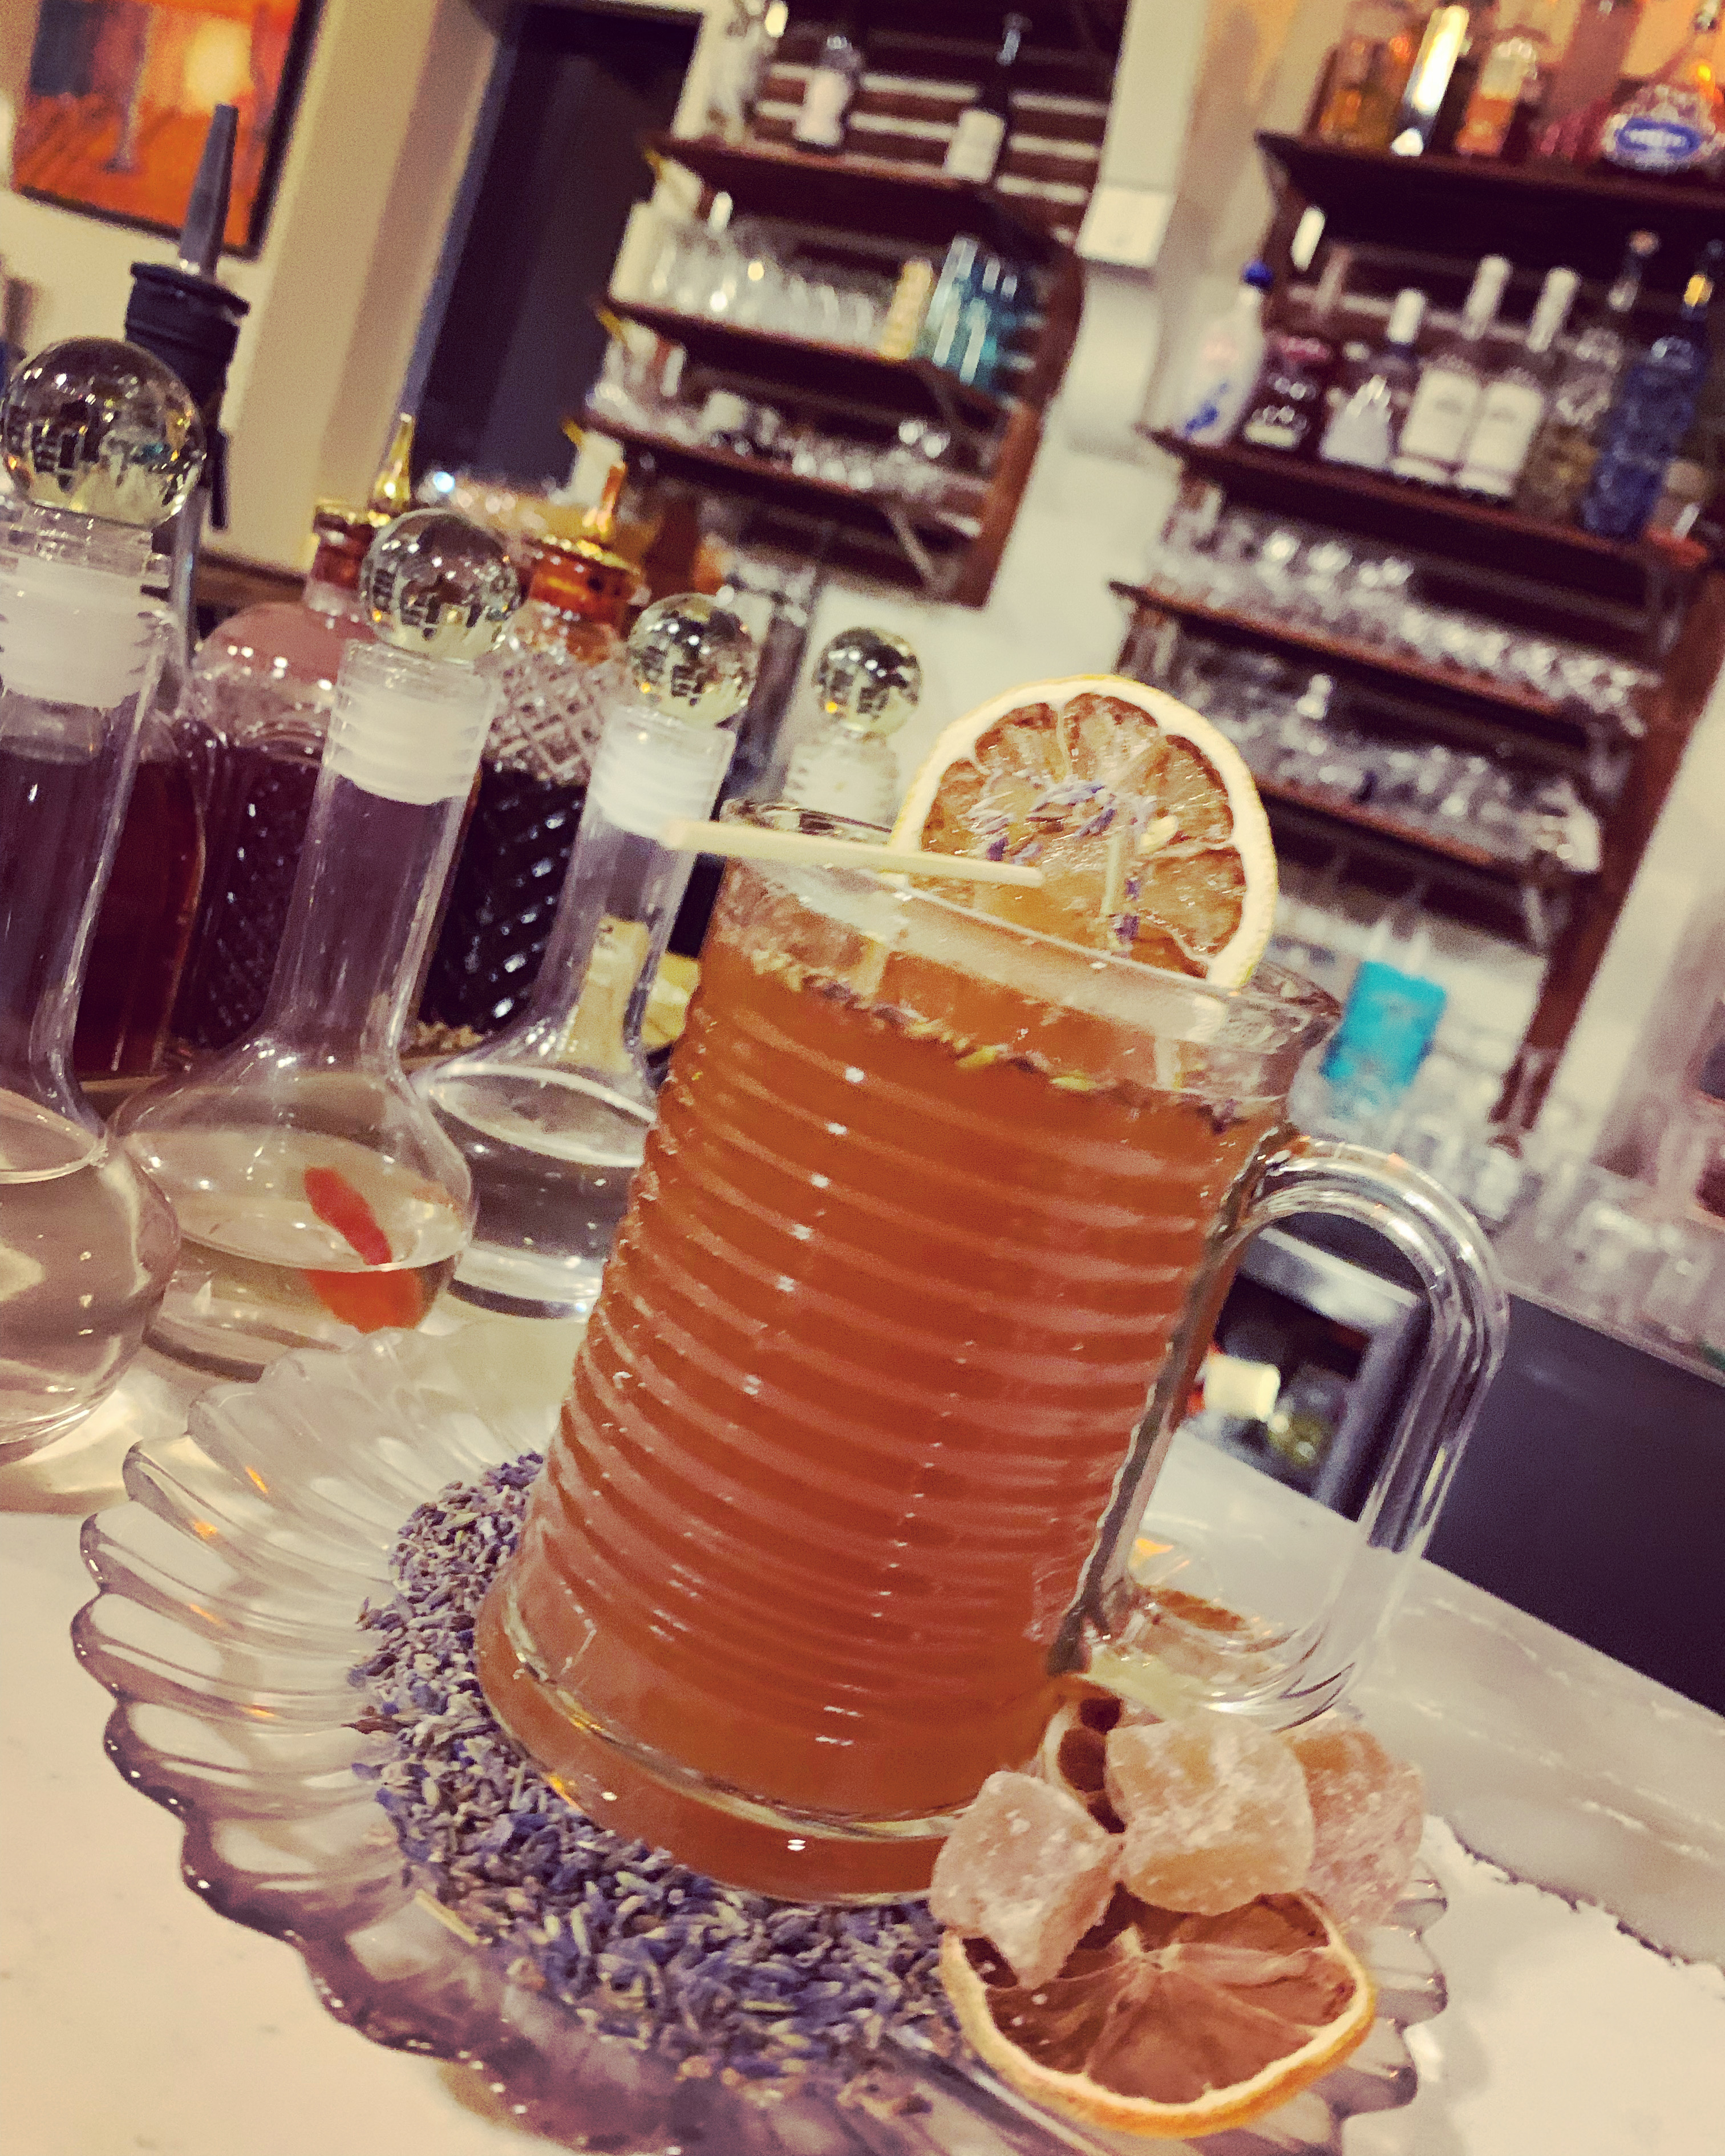
Dining
Local Relic Farmhouse
Cellermaster Wines
Shake/Stir

Slide 8
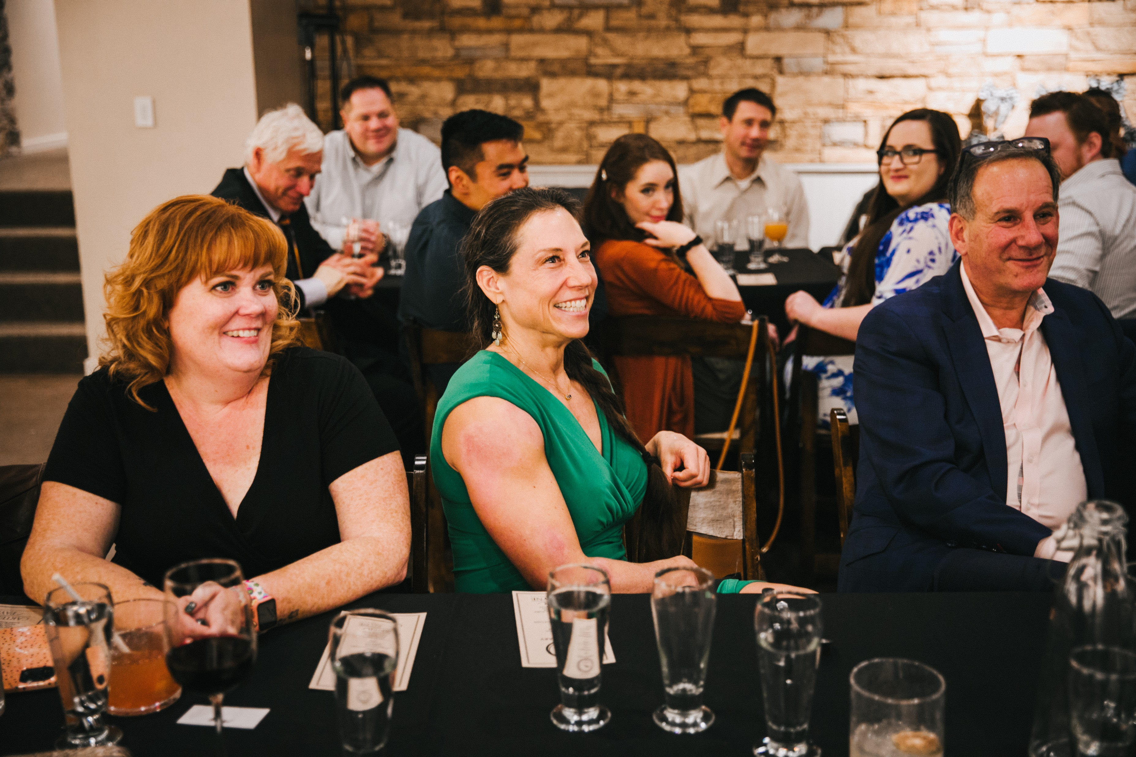
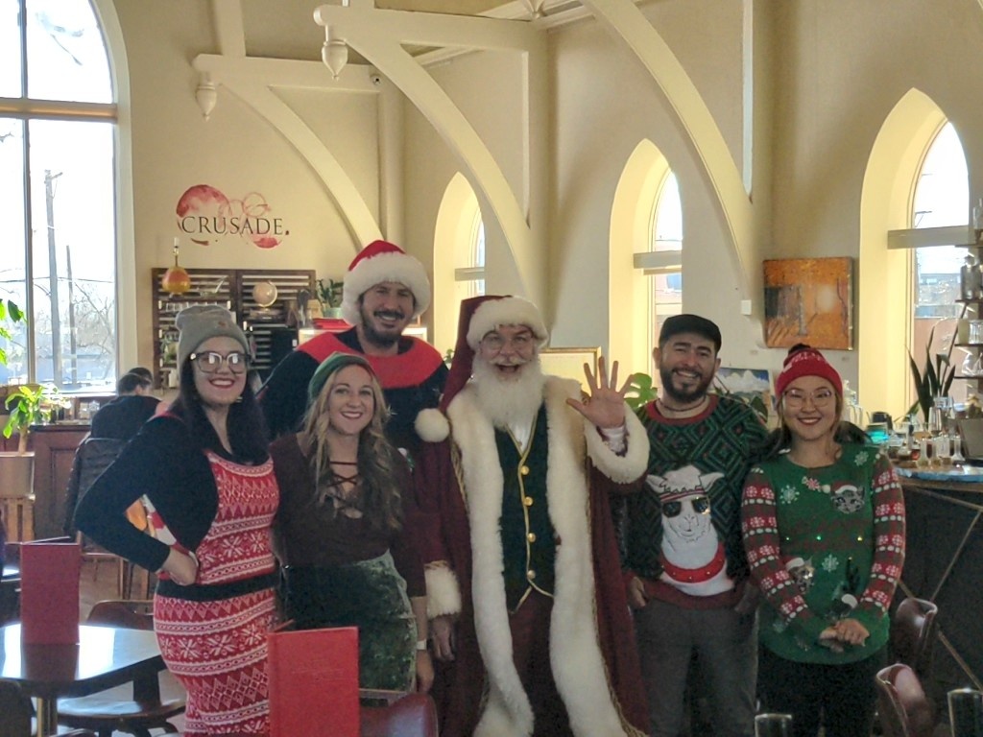
Events
Community Events
Live Music / Theater
Farmer’s Markets
Themed Festivals
Holiday Events
Private Events
Weddings / Family Gatherings
Community Organizations
Corporate Retreats
Social Gatherings

Slide 9
Who we are

Slide 10
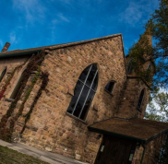
Our other projects

Slide 11
Why we are

Slide 12
impact
Destination Driver
Extended Impact
Sales Tax Generation
PLEDG Contributions
Job Creation
Job Training and Social Enterprise
Community Hub
Garden
Artist in Residence
Gathering Space
Art and History Education
Agri-Education and Agri-tourism
Sustainability and Stewardship

